Slide 1
Angular basics
Forms

Slide 2
Form types
Template-Driven forms
Reactive/Model-Driven forms

Slide 3
Template-Driven Forms
The most straightforward approach to building forms in Angular is to take advantage of the directives provided for you.
On a high-level, this is what template-driven forms achieve for us - by specifying directives to bind our models, values, validation and so on, we are letting the template do the work under the scenes.

Slide 4
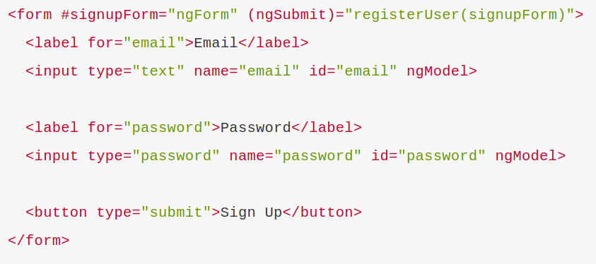
T-D form example

Slide 5
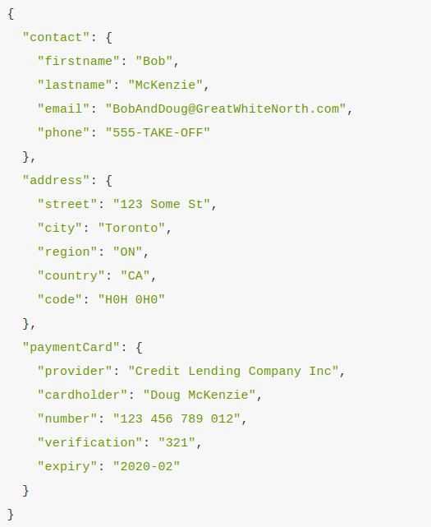
Nesting form data in T-D forms

Slide 6
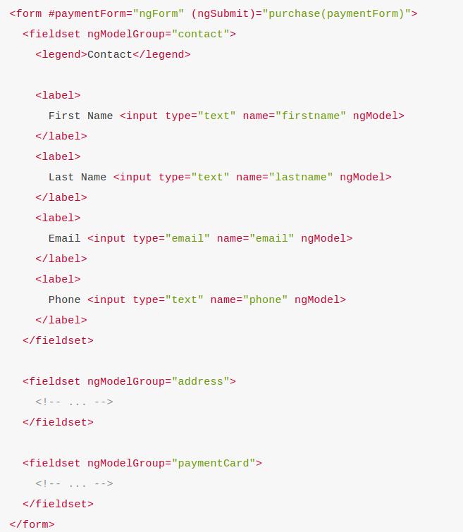

Slide 7
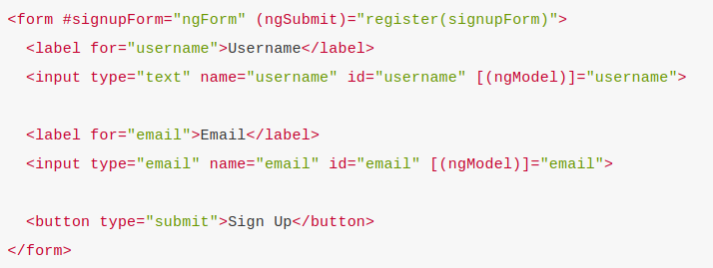
Data-binding in T-D forms

Slide 8
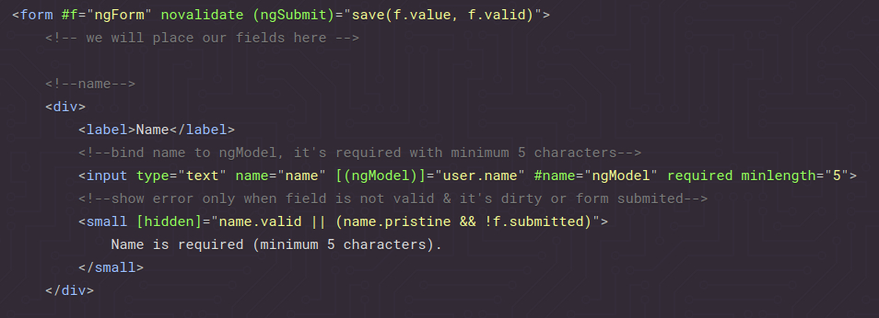
T-D forms validation

Slide 9
Reactive Forms
When we talk about “reactive” forms (also known as model-driven), we’ll be avoiding directives such as ngModel, required and friends. The idea is that instead of declaring that we want Angular to power things for us, we can actually use the underlying APIs to do them for us.

Slide 10
Reactive Forms
In a sense, instead of binding Object models to directives like template-driven forms, we in fact boot up our own instances inside a component class and construct our own JavaScript models. This has much more power and is extremely productive to work with as it allows us to write expressive code, that is very testable and keeps all logic in the same place, instead of scattering it around different form templates.

Slide 11
DEMO

Slide 12
Q&A

